Slide 1
Harnessing Federal Technology to Expedite Innovation
Brian Metzger
Senior Technology Manager
DoD Transition Lead
August 2023

Slide 2

TechLink connects businesses with technology
Authorized, federally funded non-profit.
No-cost licensing guidance.
Technology developed by
the DOD and VA laboratories for commercialization.
Wide range of technology applicable across industries.

Slide 3
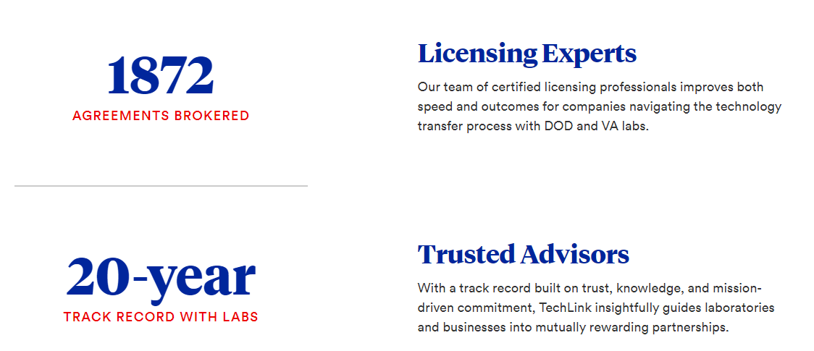
No-cost Licensing Guidance

Slide 4
Technology Licensing Benefits
Reduce
costs associated
with R&D.
Maintain
funding
traction.
De-risk
portfolios.
Enhance
technical capabilities.
Increase
market share
and competitive advantage.
Discover
new growth opportunities.

Slide 5
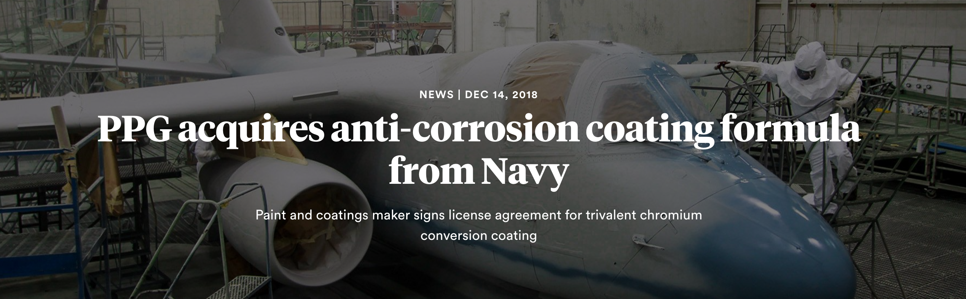
De-risk Portfolio:
Meet Shifting Regulatory Requirements — Faster

Slide 6
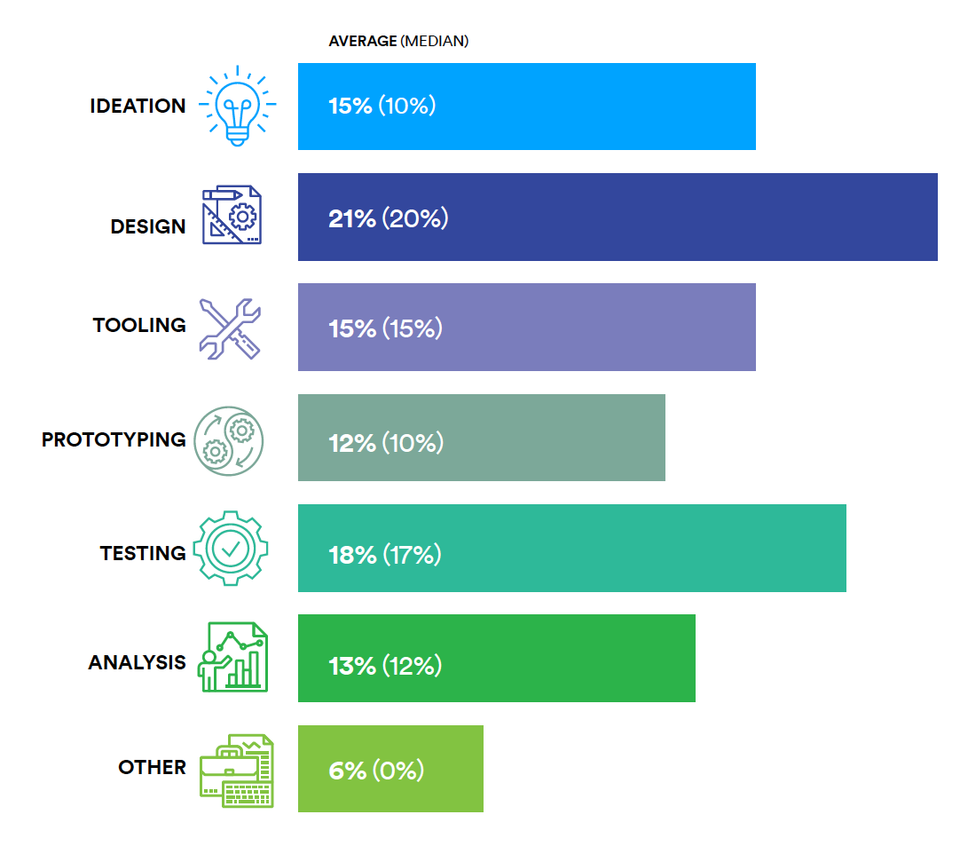
Reduce Costs Early in the Innovation Lifecycle
Immense capital investment early on

Slide 7

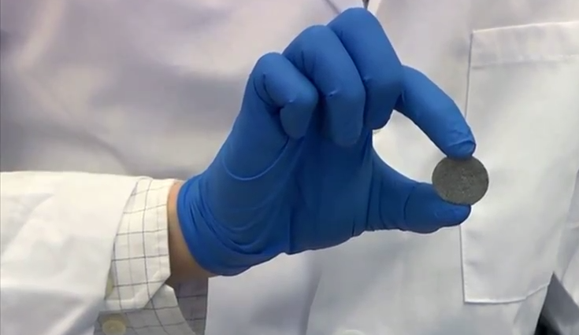
Disrupt the Market – Promise of Novel New Materials

Slide 8





Critical to Transition
LAB
INDUSTRY
WARFIGHTER
TRANSFER
TRANSITION
Notes:
Must transfer technology to industry before it can transition to military use

Slide 9
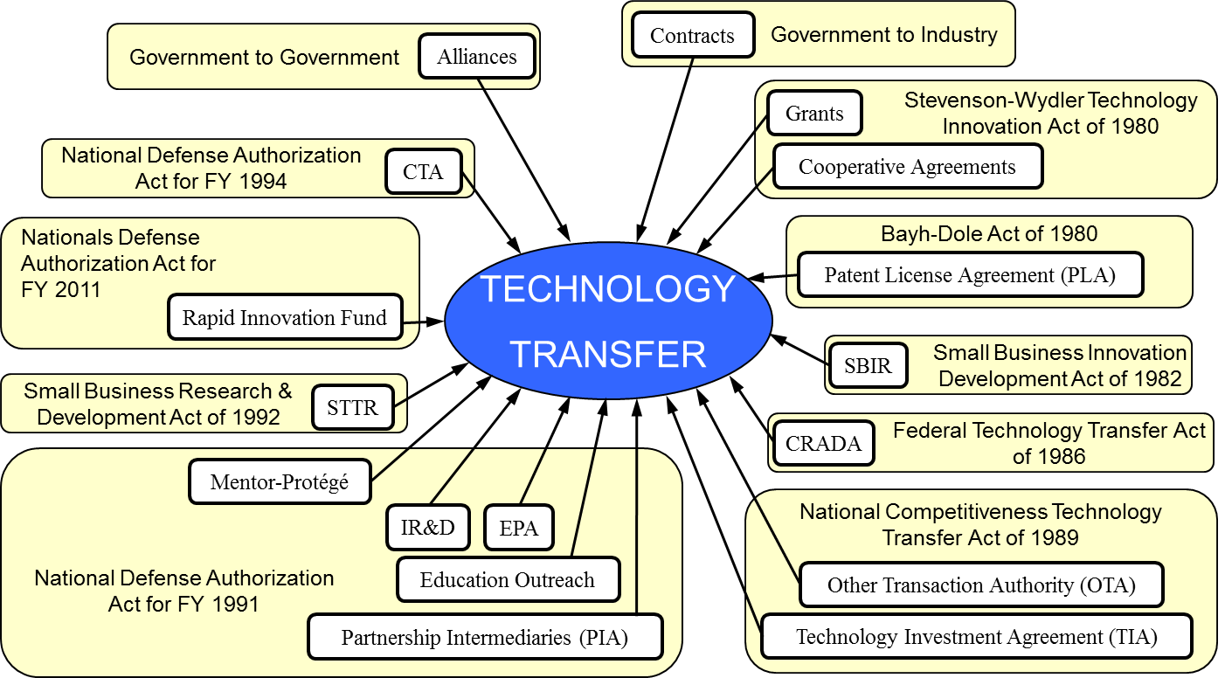
Notes:
A lot of information will be thrown at you over the next several days.
It might seem daunting
There are many tools in the technology transfer tool kit
And that is the point…T2 is broad, flexible, and powerful
But if you need some perspective…

Slide 10
Seamless Technology Transfer Process
1
2
3
4
Discover
Identify technology that fits your business needs.
Evaluate
TechLink helps
you build partnerships with labs to assess technical fit.
Apply
Create a licensing plan with support from our team
of experts.
License
Finalize licensing terms and put federal technology to work for your business.

Slide 11
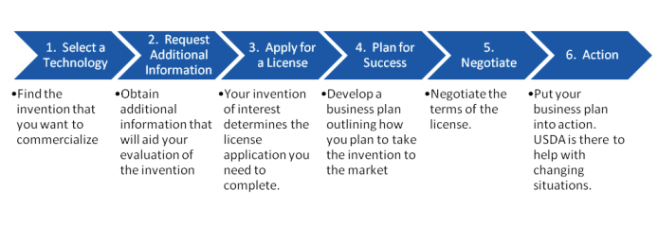
Patent Licensing Process:
Select a Technology
1. Select Technology

Slide 12
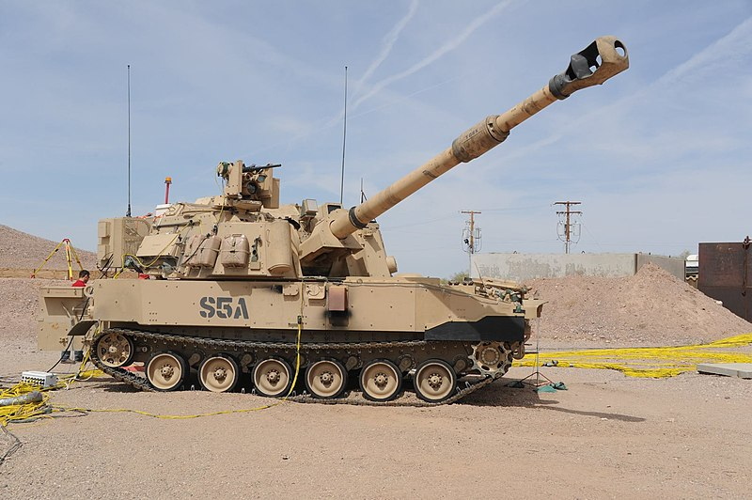
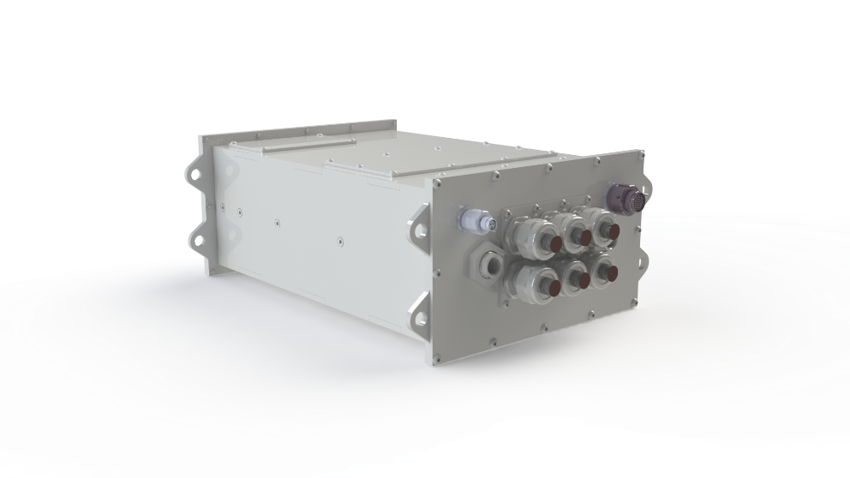
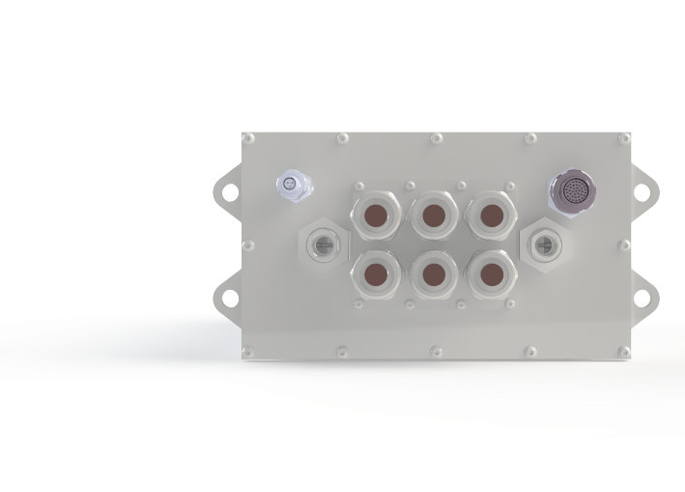
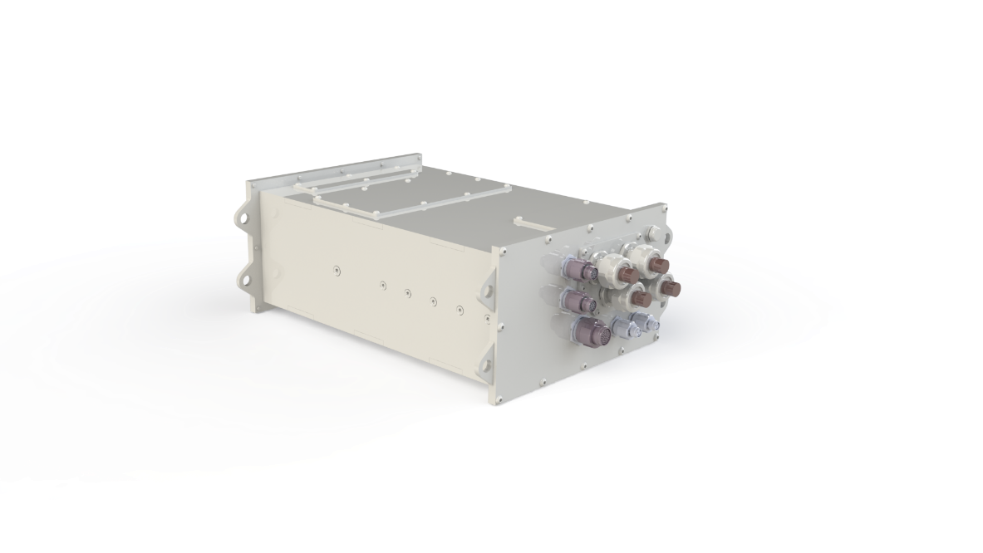
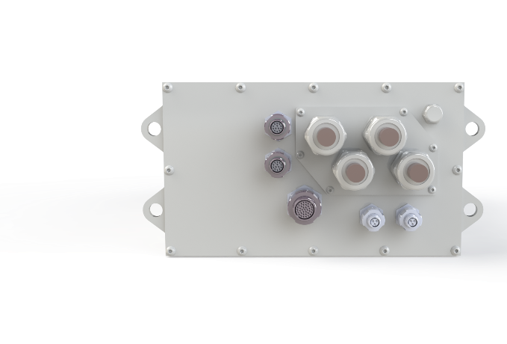
Ericsson Cycle Turbine Engine
TECHNOLOGY SPOTLIGHT
Patented Technology
Operate at Higher Temperatures
Lightweight
Enabling New Capabilities for Military Vehicles
200kW Silicon Carbide Inverter

Slide 13
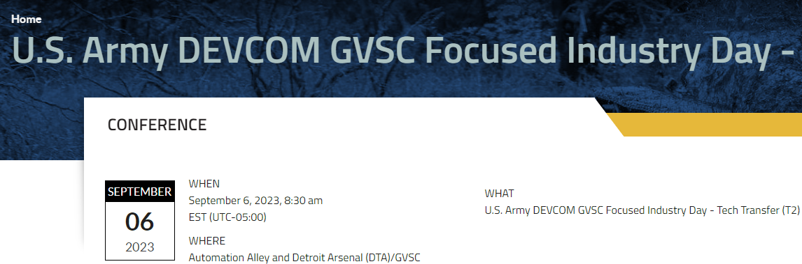
Patent Licensing Process: Step #2
Inventor Interview
2. Collect Information

Slide 14
Information Gathering Phase
Has the technology been reduced to practice (TRL)?
Any technical drawings, BOMs, and test data?
Is it part of a larger portfolio?
Are the inventors supportive, committed to the process?

Slide 15
Patent Licensing Process: Step #3
Application Process
3. Apply for a license

Slide 16
Patent Licensing Process: Step #4
Commercialization Plan
4. Plan for a success

Slide 17
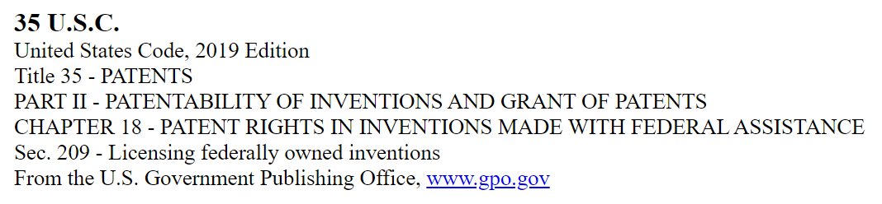
Qualifying for a Patent License
DoD wants to ensure that companies that seek to commercialize our technologies have a solid business plan for bringing the technology to market.
The Lab will review the completed license application and commercialization plan.

Slide 18

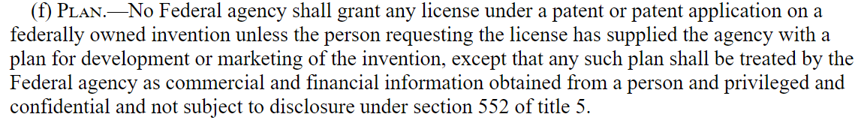
Commercialization Plan Contents
Goal: help the DoD assess your plan for developing and marketing the invention.
General understanding of the market space the applicant is hoping to enter.
Access to the resources necessary to bring this technology to market.

Slide 19

Patent Licensing Process: Step #5
Negotiate the Agreement
5. Negotiate

Slide 20
Patent Licensing Process: Step #6
Work Your Plan
6. Action

Slide 21










6000+ Technologies at Your Fingertips
Communications
Photonics
Materials
Software
Medical
Military
Energy
Electronics
Sensors
Environmental

Slide 22
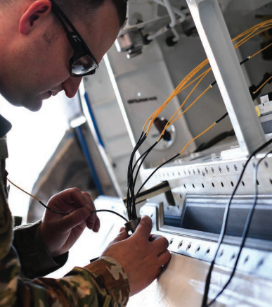


Lab to Market Through Technology Transfer
Federal Lab
R&D
U.S. Businesses Partner to Commercialize
Dual Use: Sales to
Military and/or Commercial

Slide 23

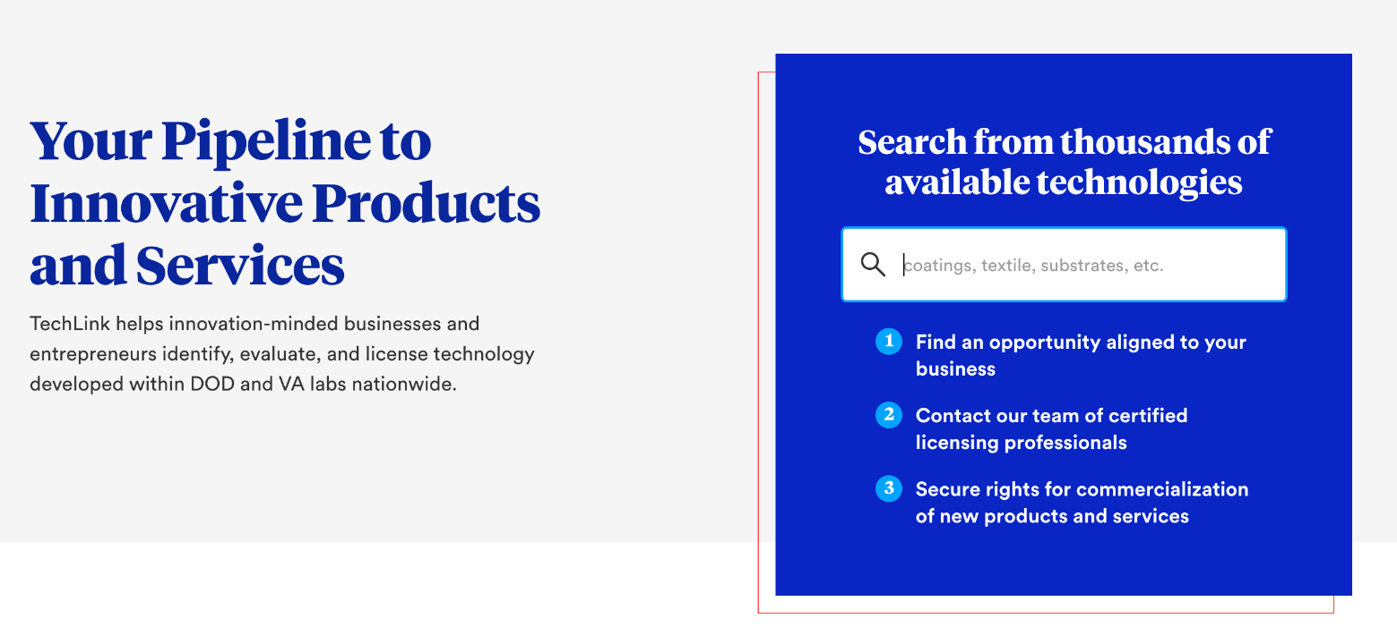
Visit Techlinkcenter.org

